Slide 2
Data Analytics
Bigdata + Spark + Cloud Bigdata

Slide 3
BIG DATA
Definition
Why this concept came?
What will be problem that exist in the traditional architecture
Cluster Computing
Distributed processing
Autoscaling

Slide 4
What will be problem that exist in the traditional architecture?
Structural data
Semi-Structural data
Unstructured data

Slide 5
In our traditional
Computer as in the binary based -> computing engine -> defined steps to store and retrieve the data as in the binary manner
Binary type string and retrieval method is common for all the 3 categories of the data.

Slide 6
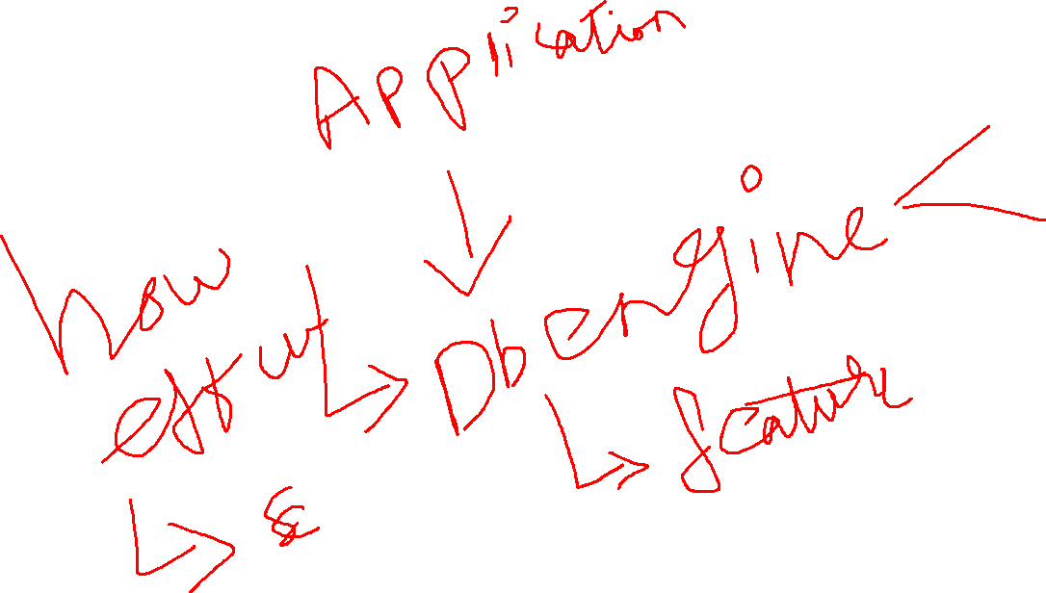
DBMS?

Slide 7
Best method to store and retrieve the data
Structural
Semi structured – json, XML – Mongo dB
Unstructured – binary

Slide 8
Databases?
Limitations
Storage -> 65,536TB -> if your company reaches the maximum limit, all your clients complaint about storage issue.
DB engine processing model some kind of limitations it will come

Slide 9
BIG DATA?
If your traditional architecture reached the maximum limitation by means of storage and computing resource
Data base
MAIL -> maximum storage it will support ->
Big data is a field that treats ways to analyze, systematically extract information from, or otherwise deal with data sets that are too large or complex to be dealt with by traditional data-processing application software.

Slide 10
How bigdata works?
Cluster Computing?
Method of combining multiple systems together via network(internal/external) and performing some task
Distributed Computing ?
Once all the systems combined together, from all the systems we fetch the resources and combine as one logical unit and we will run an software on top of it

Slide 11
Software that will run on top of cluster and use the distributed computing resources
Distributed computing resource
Storage(Hard drive space)
Processing(CPU Cores and RAM)

Slide 12
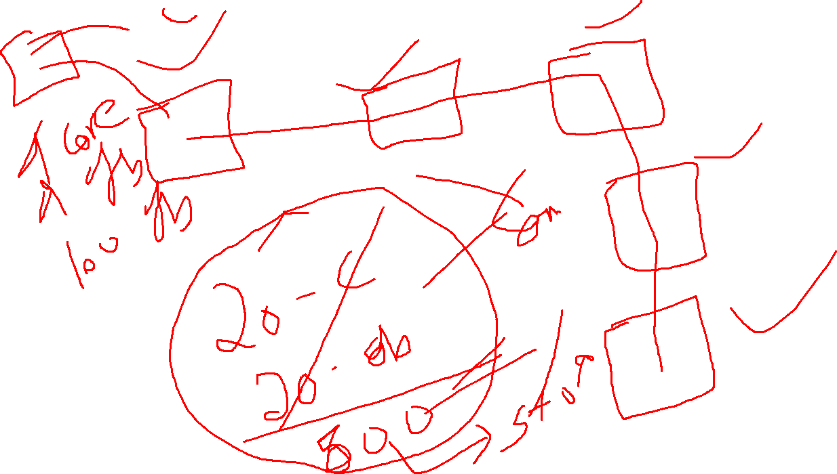

Slide 13
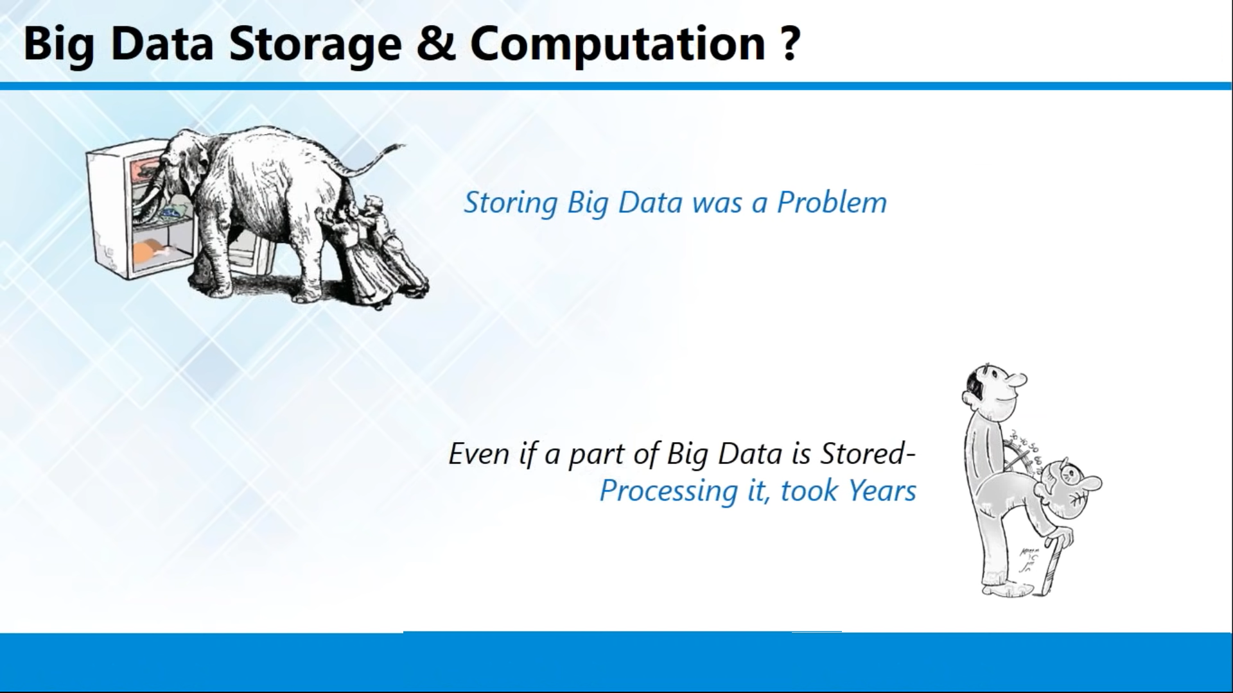

Slide 14
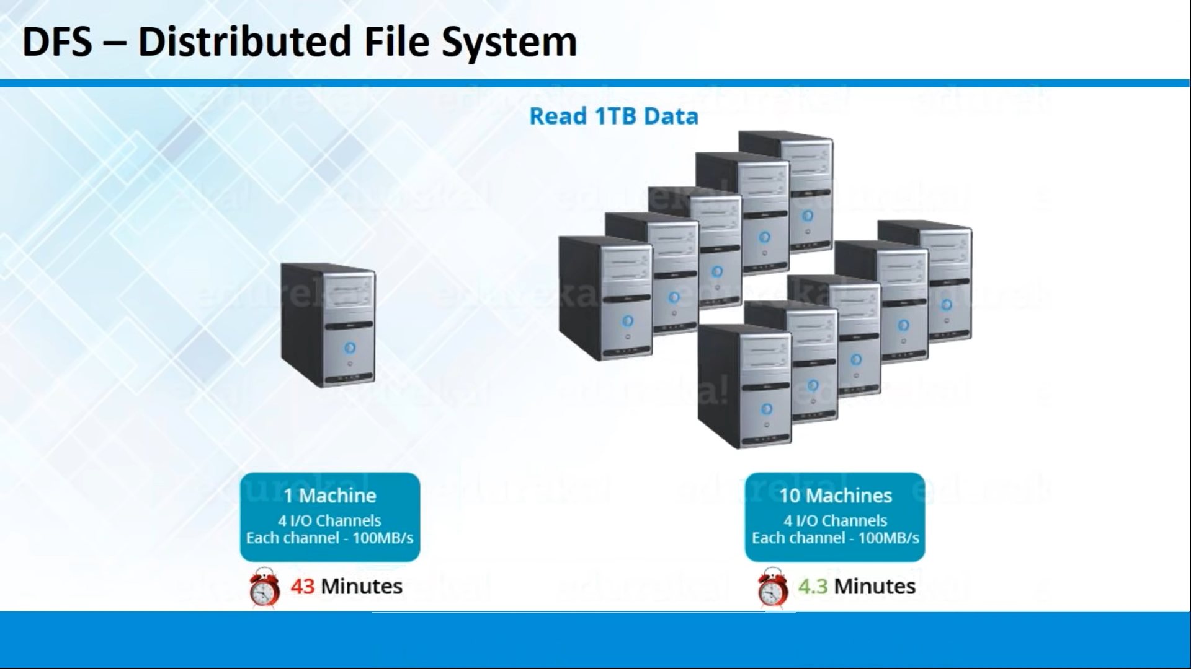

Slide 15
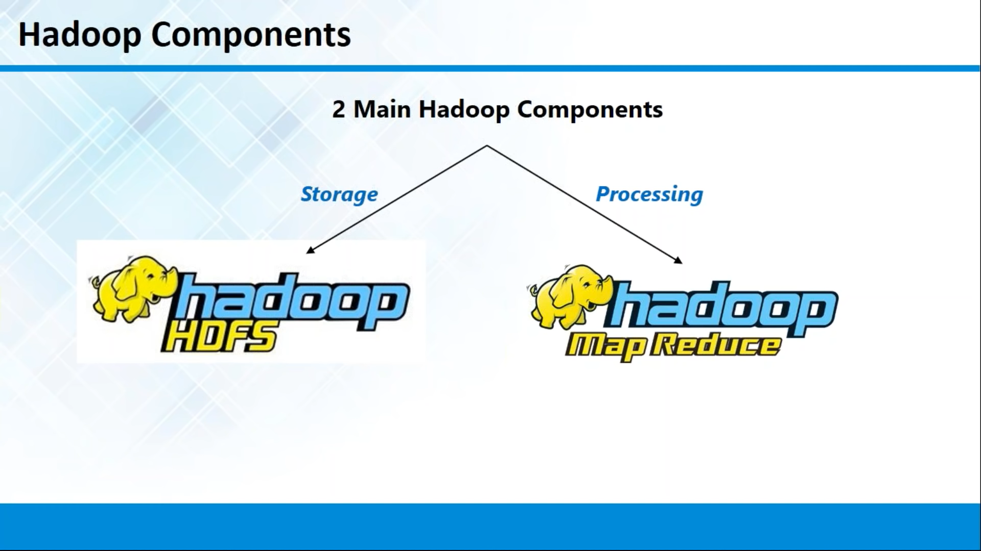

Slide 16
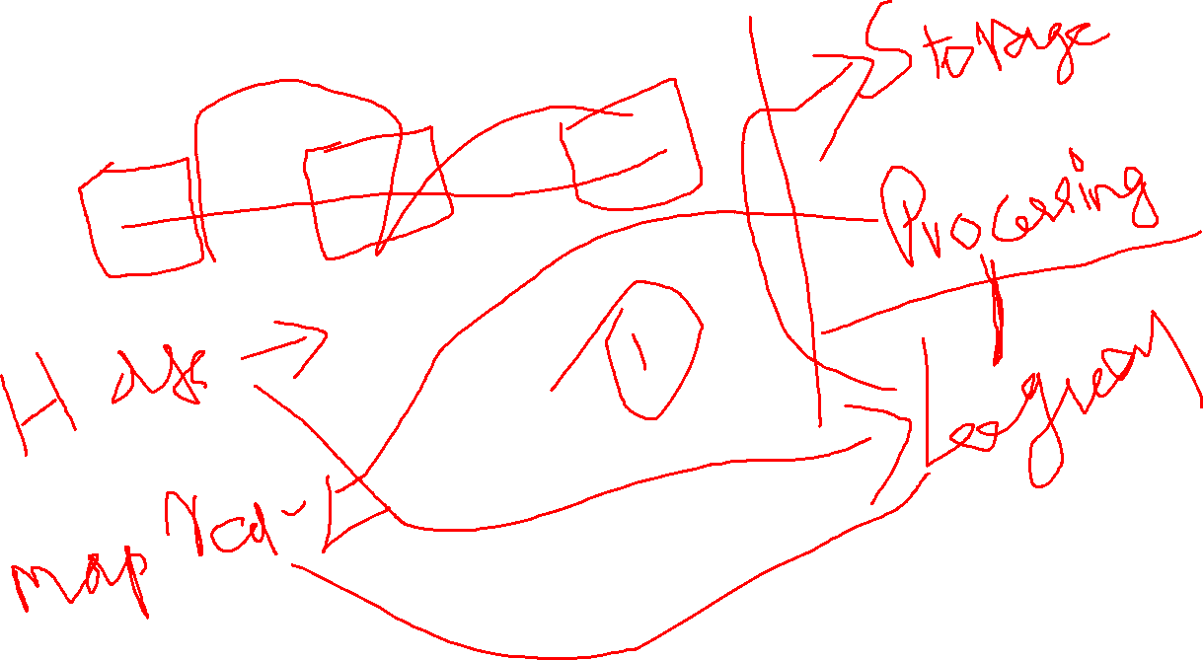

Slide 17
Hadoop Process
Cluster -> Master + Slave
Storage -> Master process -> Name Node
Storage -> Slave process -> data node
MapReduce -> Master Process -> Resource Manager
MapReduce -> Slave process -> Task Manager

